Slide 1
Candy 24 bits RISC-V style CPU Part 1: Register File
Zhiwei Luo & Qingruo Si
2018.11.28

Slide 2

RISC-V
RISC-V is a free and open Instruction set architecture
Enables a new era of processor innovation through open standard collaboration.
Born in academia and research, RISC-V ISA delivers a new level of free, extensible software and hardware freedom on architecture, paving the way for the next 50 years of computing design and innovation.
cite: https://riscv.org/

Slide 3
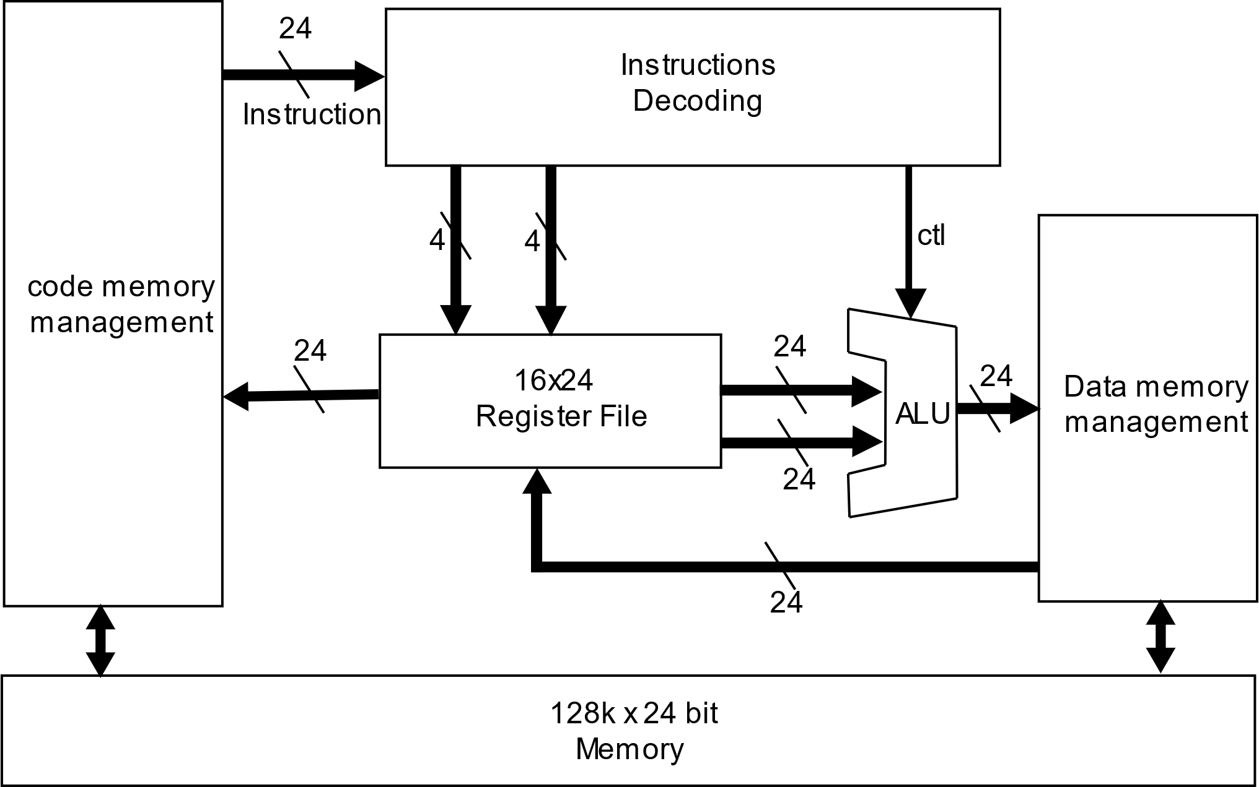
Systematic Overview

Slide 4
Customized RISC-V ISA Specification
Inst | Function | type | TypeCode | Opcode
add | Add | R | 00 | 000000
addi | Add immediate | I | 01 | 0000
sub | Sub | R | 00 | 000001
mul | Mul | R | 00 | 000010
div | Div | R | 00 | 000011
divu | Div unsigned | R | 00 | 000100
rem | Rem | R | 00 | 000101
remu | Rem unsigned | R | 00 | 000110
and | And | R | 00 | 001000
andi | And immediate | I | 01 | 0001
or | Or | R | 00 | 001001
ori | Or immediate | I | 01 | 0010
xor | Xor | R | 00 | 001010
xori | Xor immediate | I | 01 | 0011
sll | Shift left | R | 00 | 010000
slli | Shift left immediate | I | 01 | 0100
sra | Shift right arithmetic | R | 00 | 010001
srai | Shift right arithmetic immediate | I | 01 | 0101
srl | Shift right | R | 00 | 010010
srli | Shift right immediate | I | 01 | 0110
slt | Set less than | R | 00 | 100000
slti | Set less than immediate | I | 01 | 0111
sltiu | Set less than immediate unsigned | I | 01 | 1000
beq | Branch if equal | SB | 10 | 0000
bge | Branch if >= | SB | 10 | 0001
bgeu | Branch if >= unsigned | SB | 10 | 0010
blt | Branch if < | SB | 10 | 0011
bltu | Branch if < unsigned | SB | 10 | 0100
bne | Branch if != | SB | 10 | 0101
jal | Jump and Link | UJ | 11 | 000
jalr | Jump and Link register | I | 01 | 1001
lb | Load byte | I | 01 | 1010
lw | Load word | I | 01 | 1011
lui | Load upper immediate | U | 11 | 101
lli | Load lower immediate | U | 11 | 100
sb | Store byte | S | 10 | 1000
sw | Store word | S | 10 | 1001
Word | 24bit
Half-word | 16bit
Byte | 8bit
R | 14
I | 12
S/SB | 8
U/UJ | 3
R(Register) | Typecode | Opcode | RS1 | RS2 | RD
I(immediate+Reg) | Typecode | Opcode | RS1 |  | RD | imm
S(Reg+Addr) | Typecode | Opcode | RS1 | RS2 |  | imm(addr)
SB(Branch) | Typecode | Opcode | RS1 | RS2 |  | imm
U(big imm) | Typecode | Opcode |  |  | RD | imm(big)
UJ(Jump addr) | Typecode | Opcode |  |  | RD | imm(addr)
Inst Coding | TypeCode(2b) | Opcode | RS1 | RS2 | RD | imm
R | 00 | 6b | 4b | 4b | 4b | 4b(unused)
I | 01 | 4b | 4b |  | 4b | 10b
S/SB | 10 | 4b | 4b | 4b |  | 10b
U/UJ | 11 | 2b |  |  | 4b | 16b

Slide 5
Calling Convention
Register | ABI name | Description | Saver
R0 | zero | Hard-wired 0
R1 | RA | Return Addr | caller
R2 | SP | Stack Pointer | callee
R3 | FP | Frame Pointer | callee
R4 | A0/RV | Arg0/Return value | callee
R5 | A1 | Arg1 | callee
R6 | A2 | Arg2 | callee
R7 | A3 | Arg3 | callee
R8 | S0 | Saved register | callee
R9 | S1 | Saved register | callee
R10 | S2 | Saved register | callee
R11 | S3 | Saved register | callee
R12 | T0 | Temporaries | caller
R13 | T1 | Temporaries | caller
R14 | T2 | Temporaries | caller
R15 | T3 | Temporaries | caller
PC | PC

Slide 6
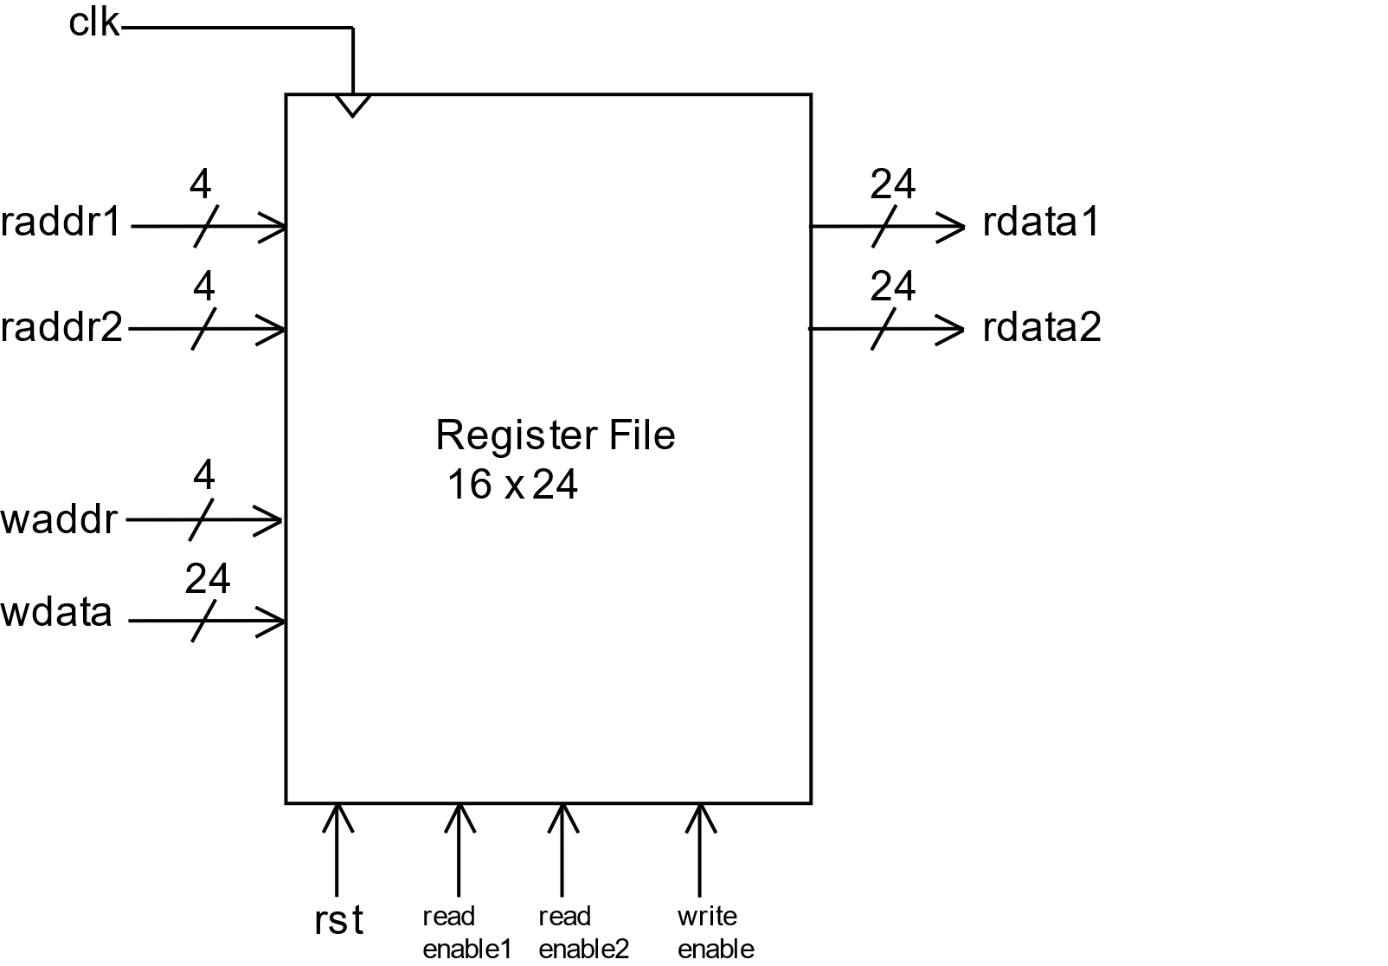
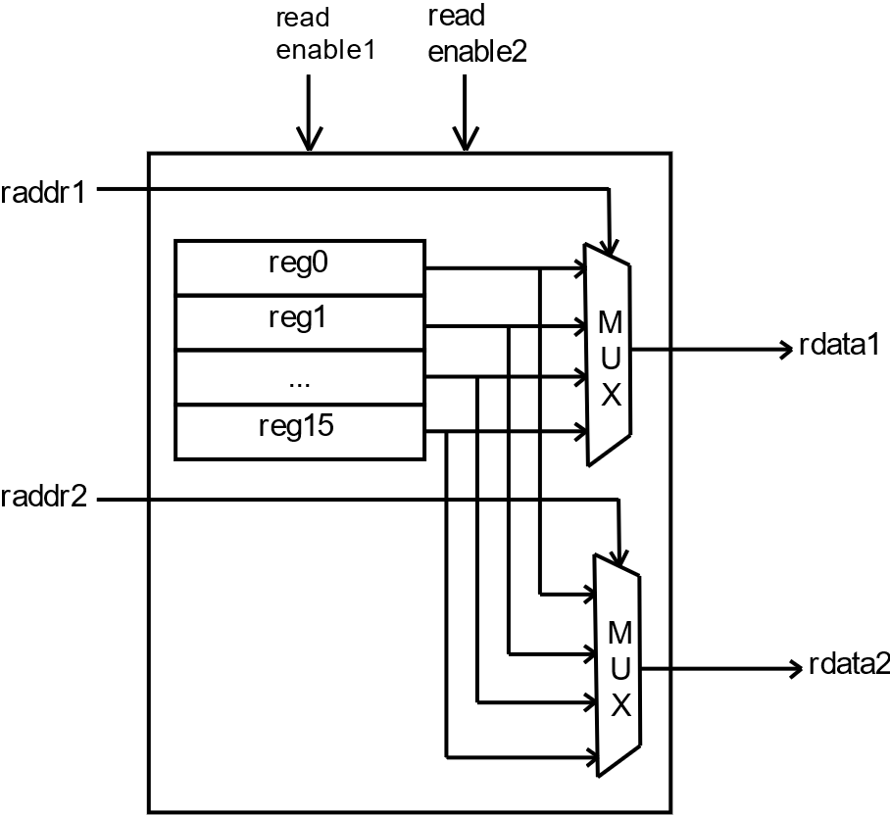
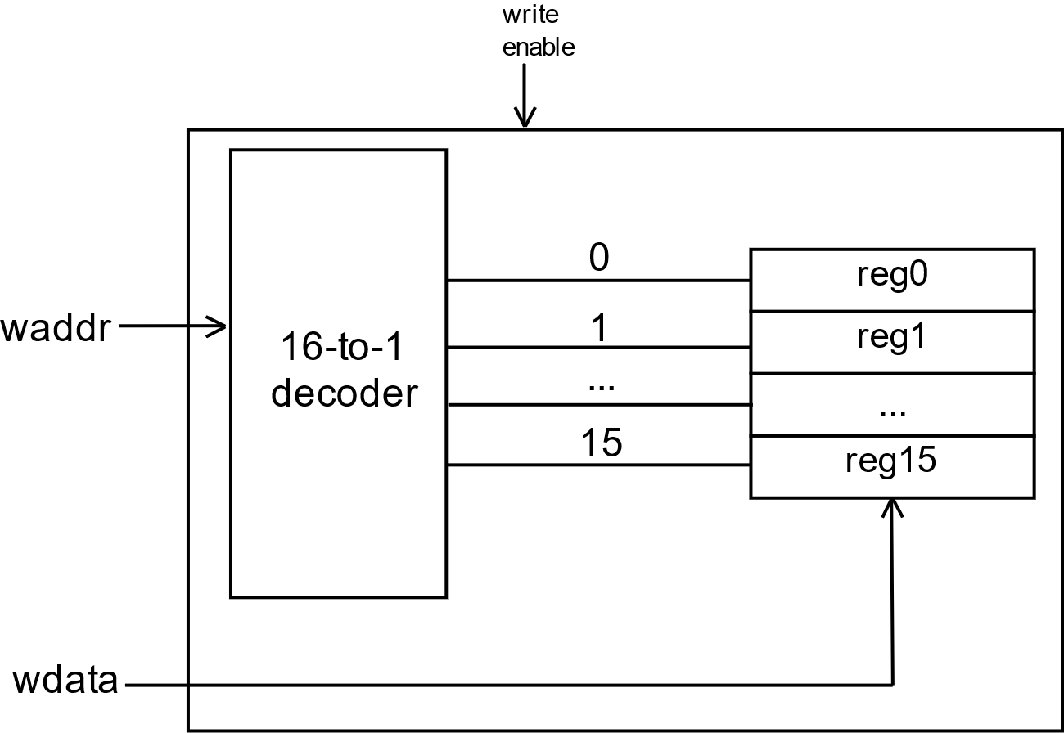
Register File
Read
Write

Slide 7
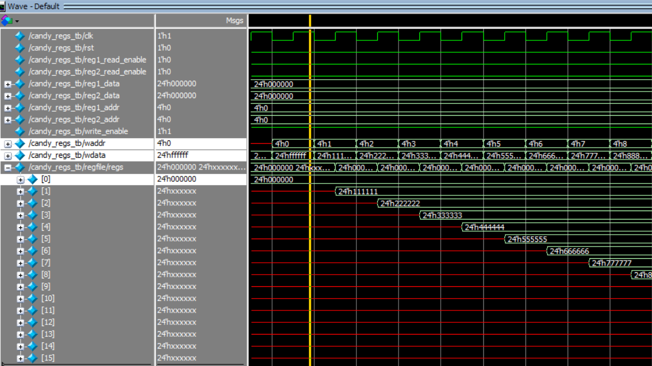
ModelSim Simulation Result
R0:
Hard-wired zero

Slide 8
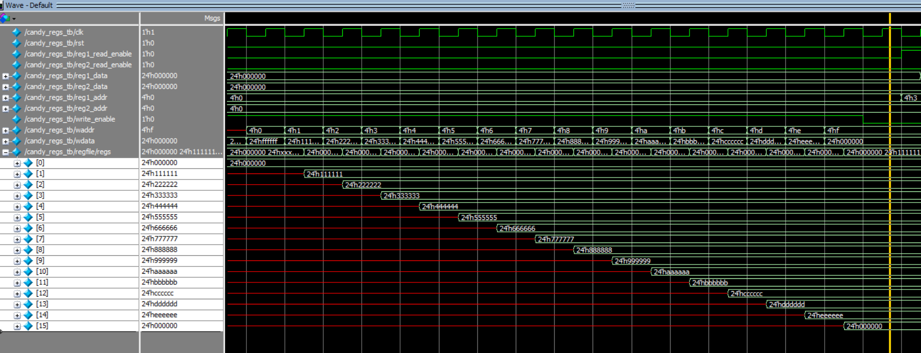
ModelSim Simulation Result
write

Slide 9
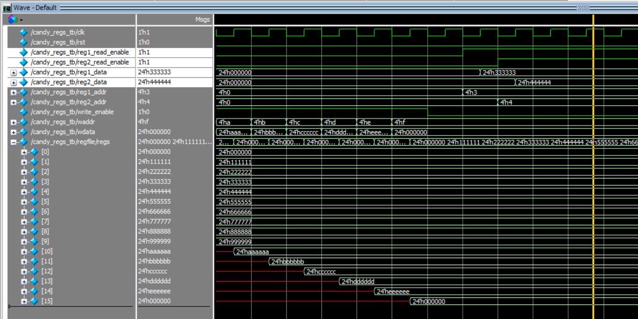
ModelSim Simulation Result
Read

Slide 10
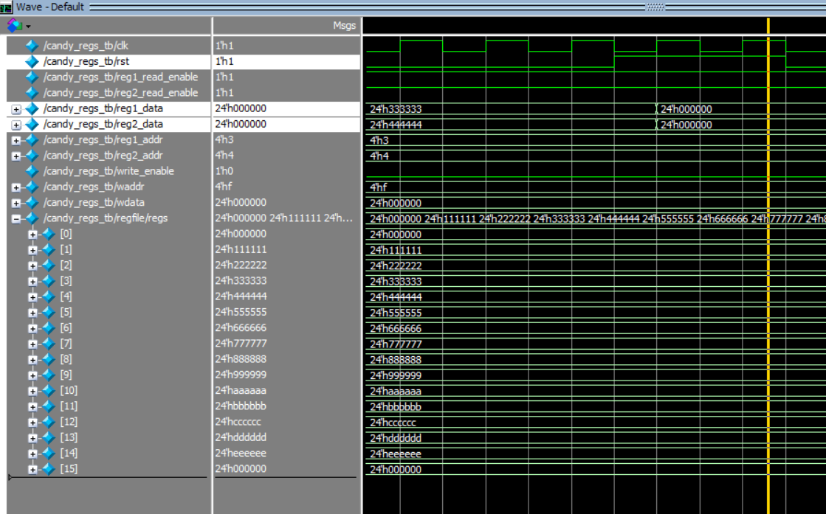
ModelSim Simulation Result
Reset

Slide 11
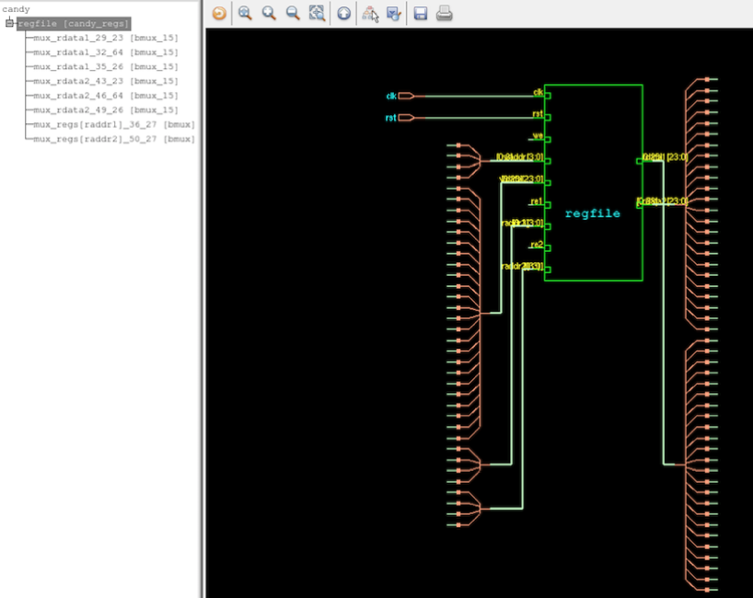
Synthesis
Register file

Slide 12
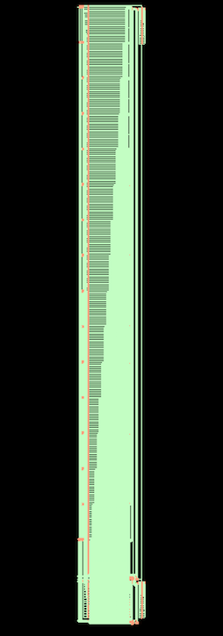
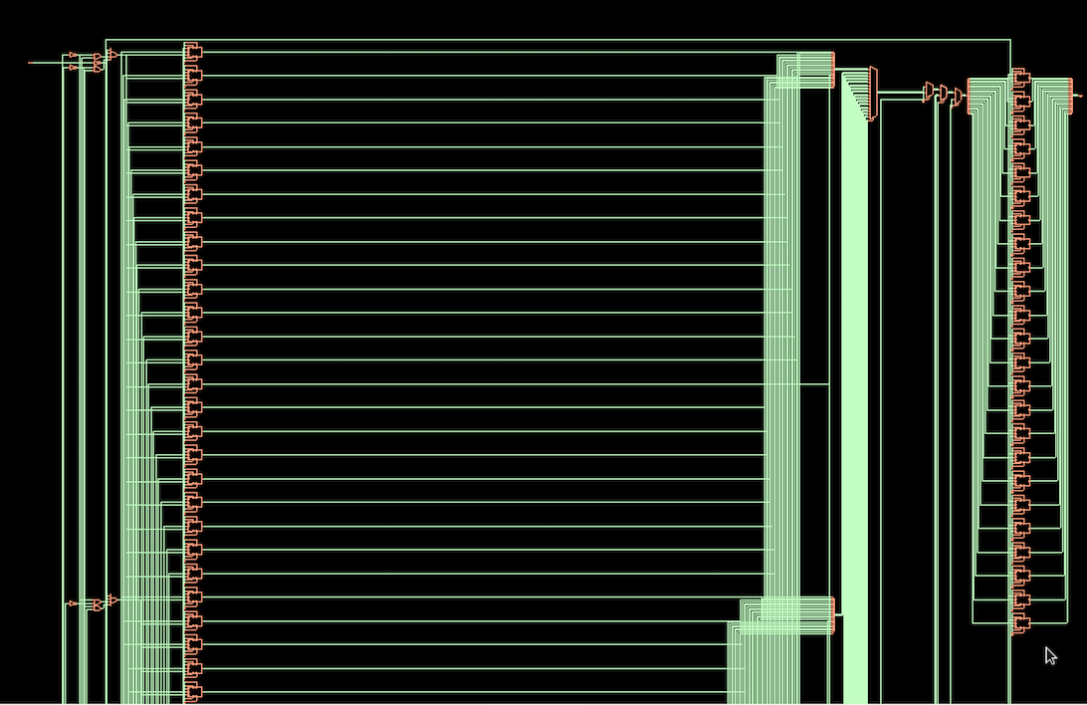
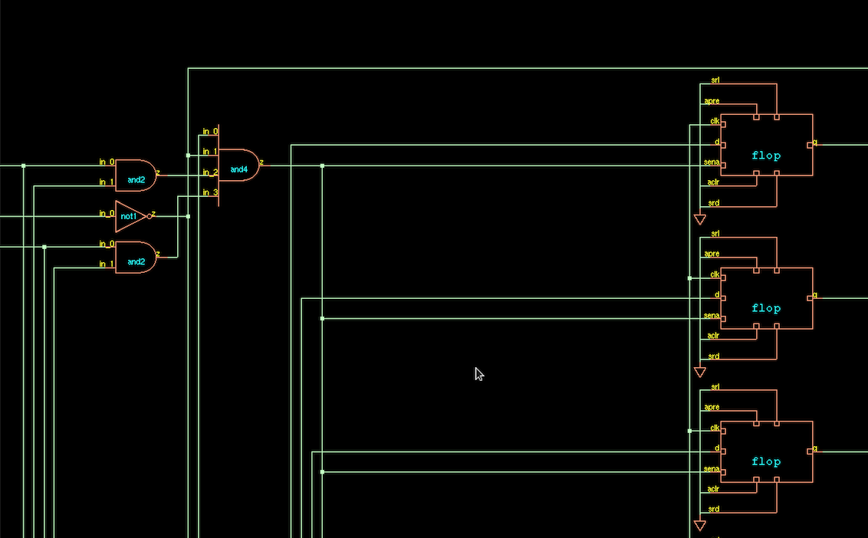
24 bits Register

Slide 13
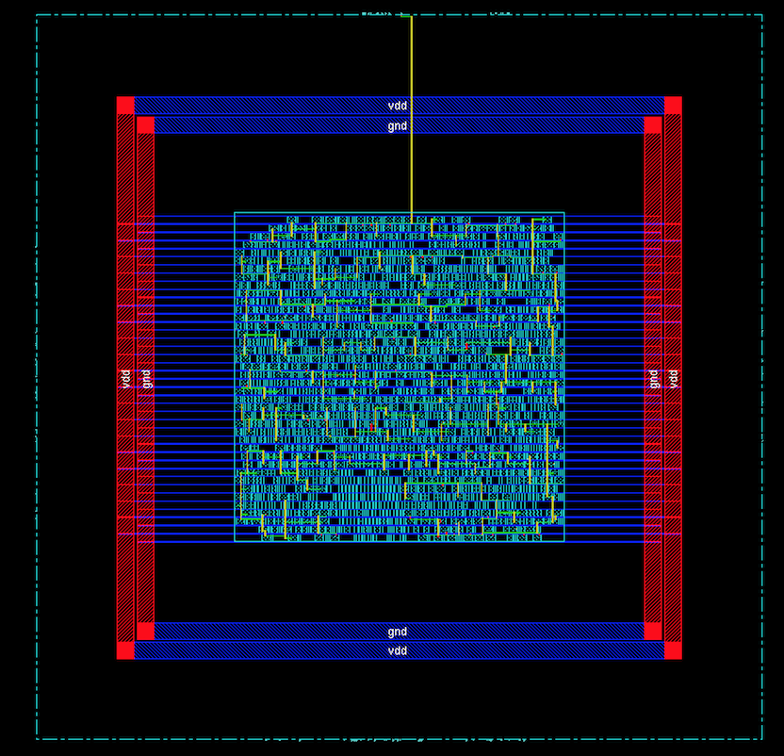
Place and Route
Layout after adding clock tree

Slide 14
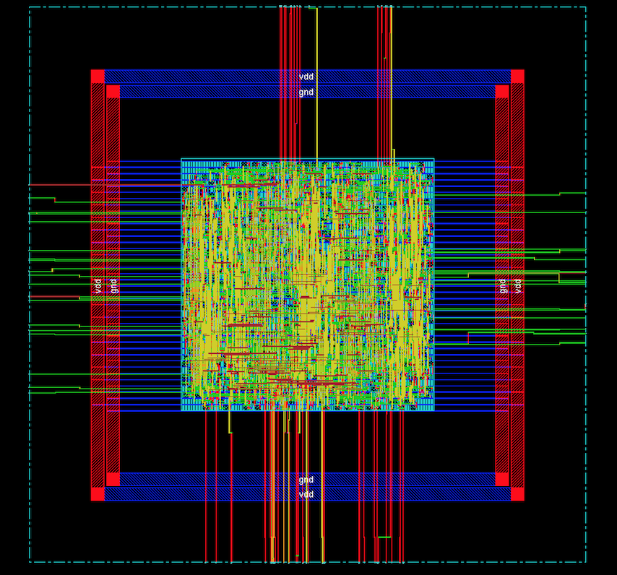
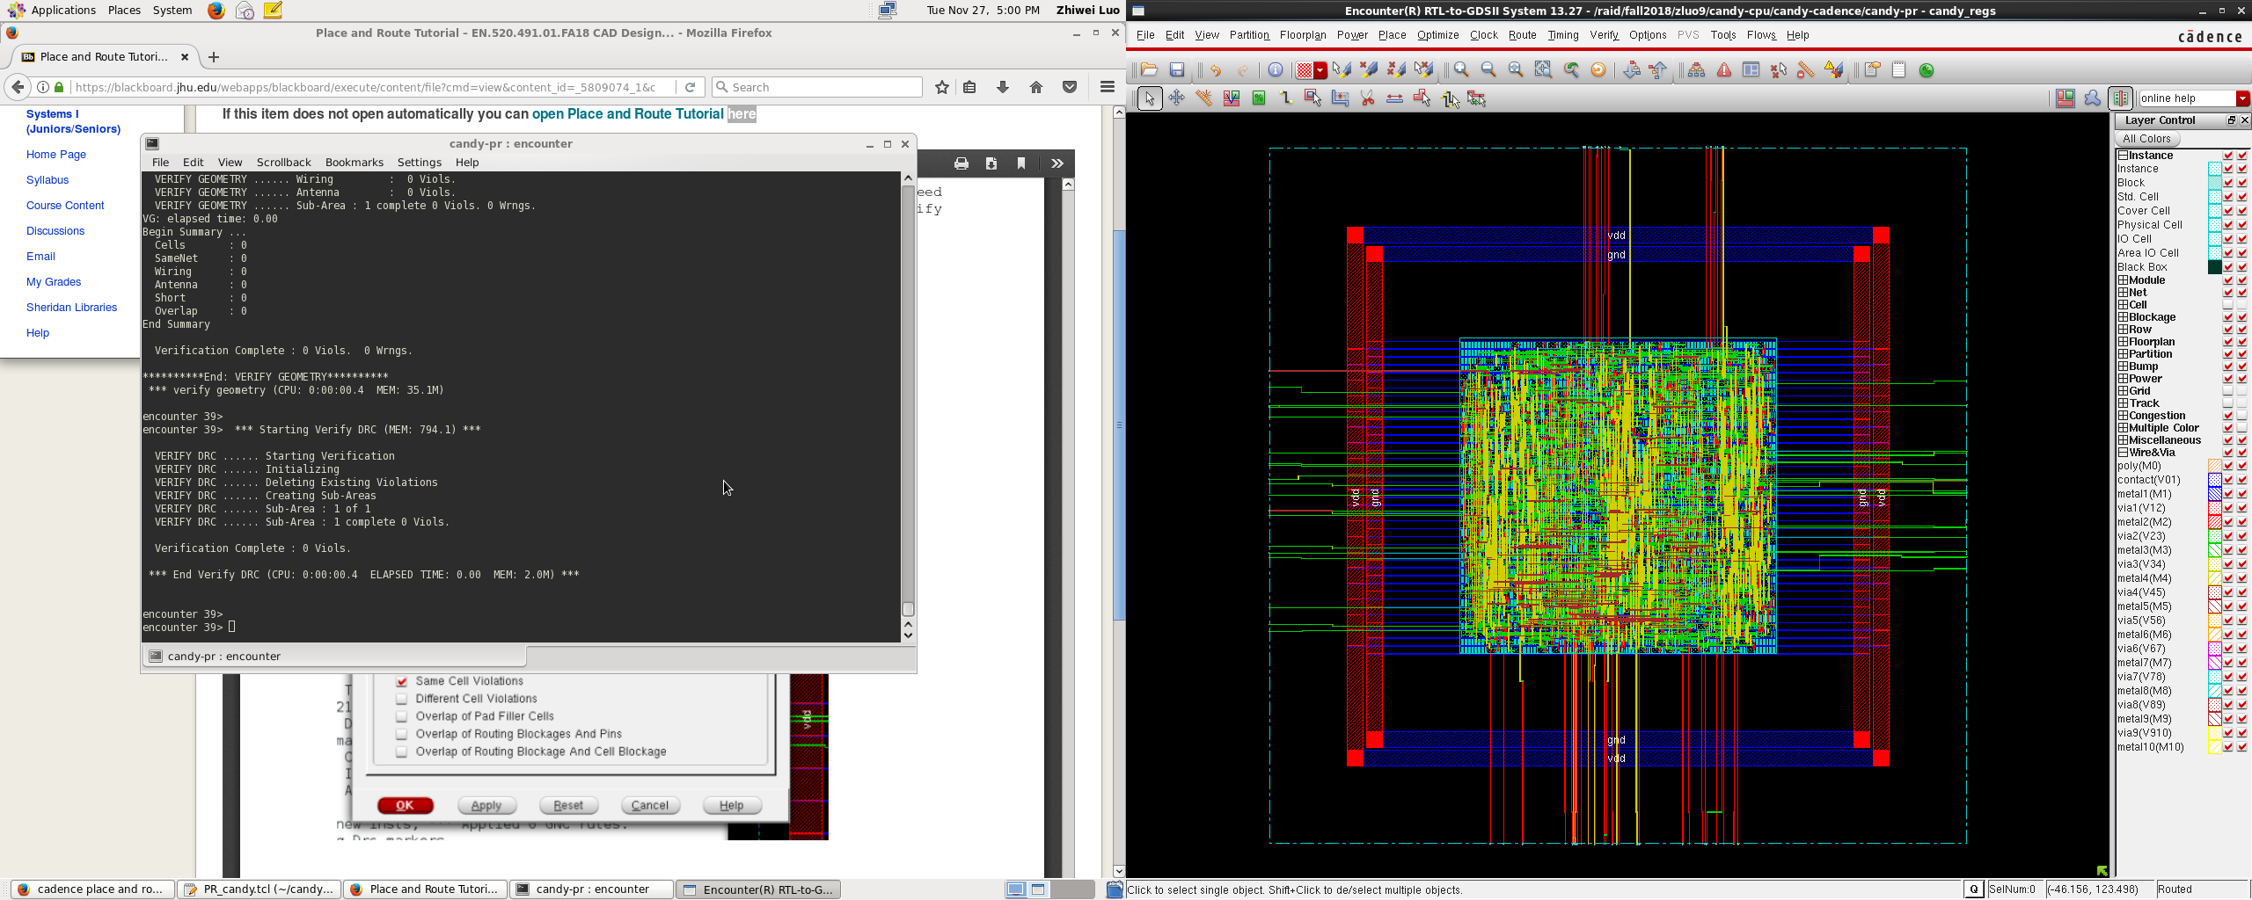
Layout after Routing

Slide 15
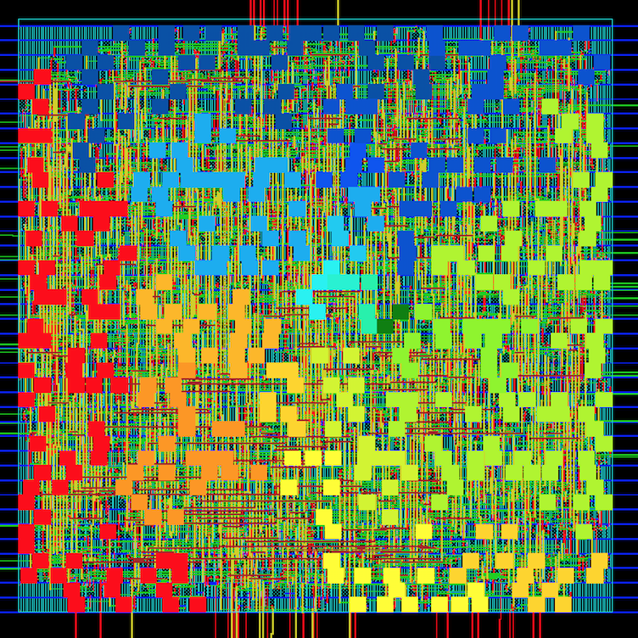
Timing delay

Slide 16
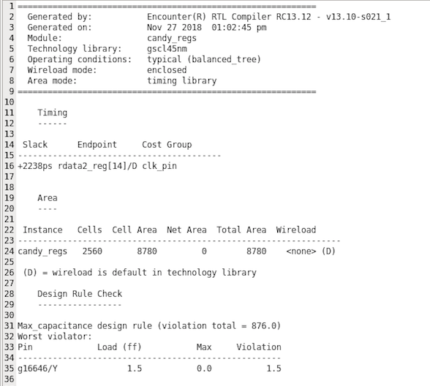
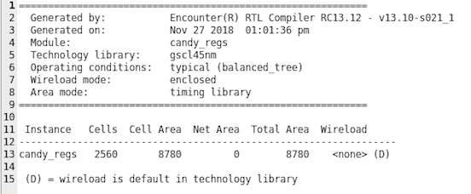
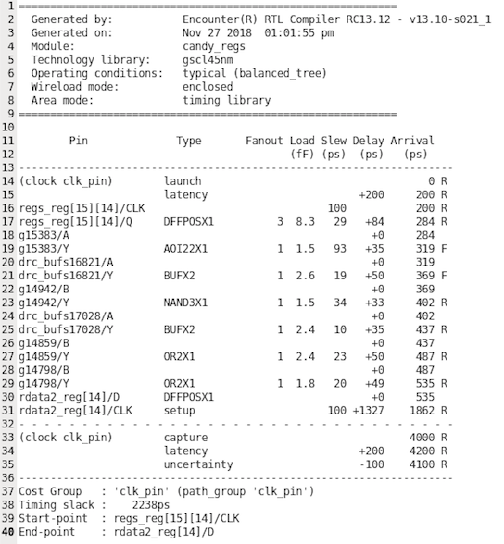
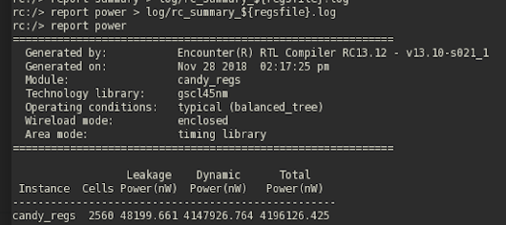
Size & Power Report
Summary
2
Area
8780 nm
Timing
2238 ps
Power
4,196,126.425 nW

Slide 17
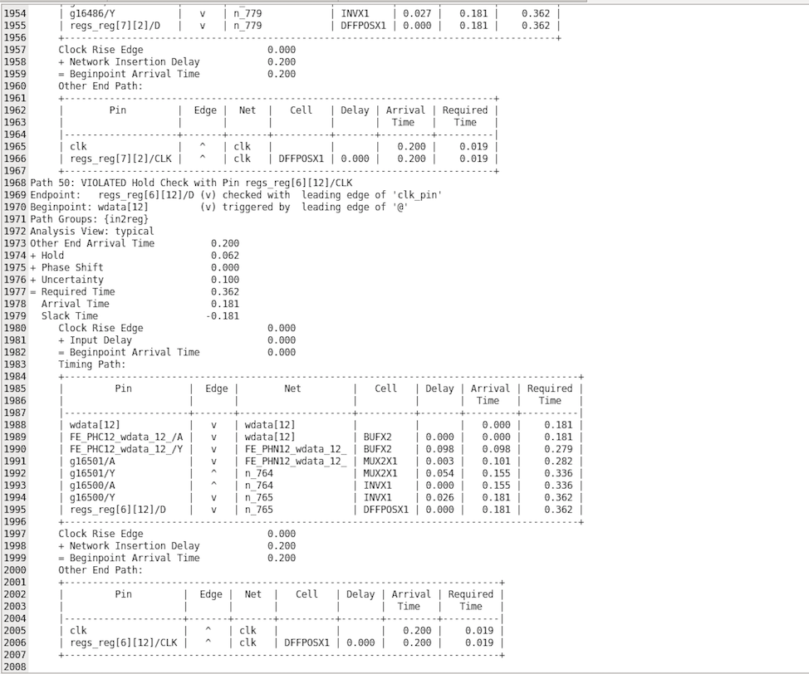
Question?

